Slide 1
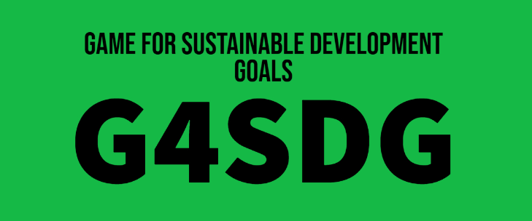
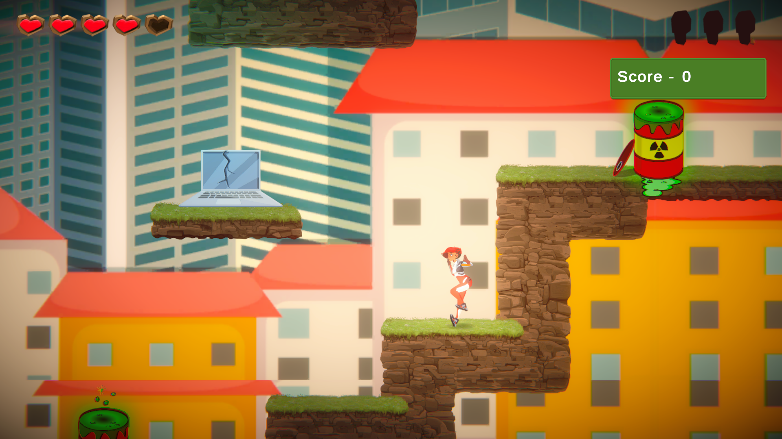
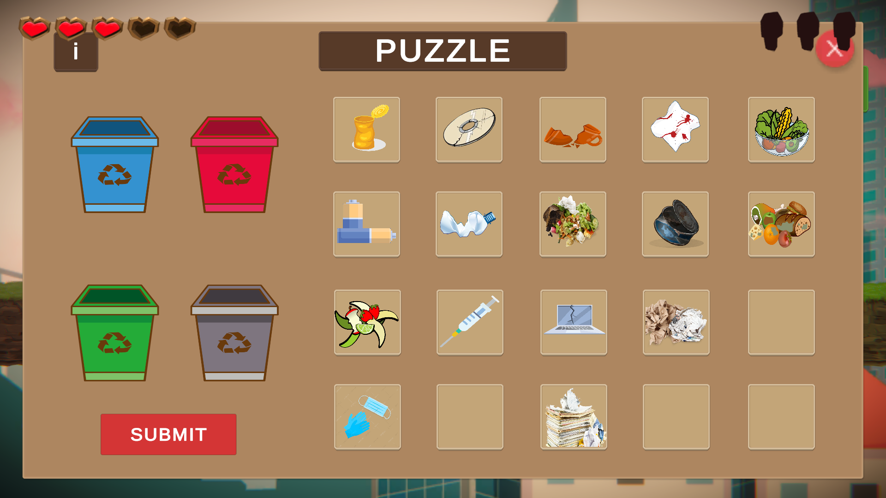
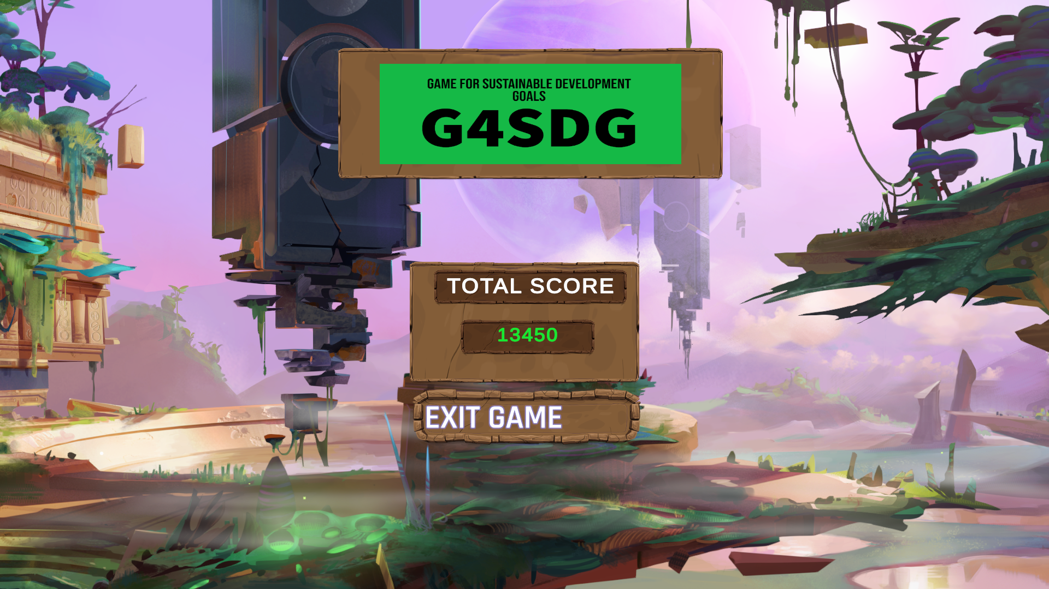
Goals Targeted:
Clean Water and sanitation
Life on Land
Zero Hunger
Gamifying the sustainability of our planet!
Veda goes on a mission to clean the environment, protect animals and end hunger!!
Why does our solution work?
Interactive
Score driven
Multiplayer extension possible
Any existing solutions so far?
No score based competitive educational games were to be found.
Github Link: https://github.com/IshaanKulkarni/G4SDG-game

